Slide 1



Steerable Antenna For Rocket Monitoring System
Amos Kipngetich Korir Jerry Joseph Mumo
ENE 211-0029/2019
ENE212-0236/2019
(EEE LC) (ECE)

Slide 2
Problem Statement and Justification
Telemetry Data Loss
Communication Challenges
Parachute
Ejection Failure
Difficulty in Rocket Retrieval

Slide 3




Task accomplished
Designing of the antenna Acquisition of components Design of sensor network

Slide 4

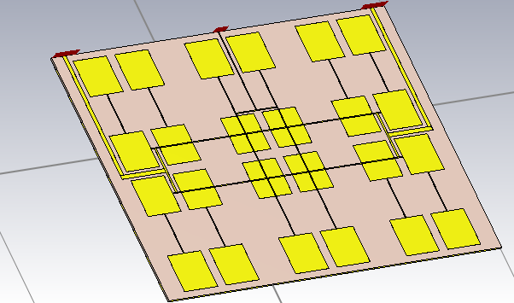

Ground Station Patch antenna
Patch Antenna Array switched line phased
array

Slide 5

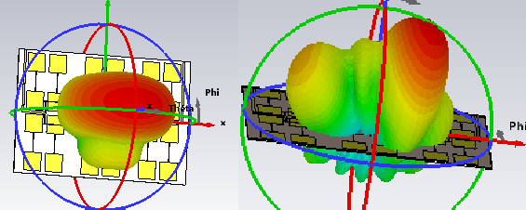


Farfield simulation

Slide 6
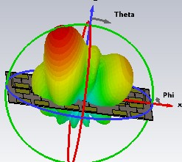
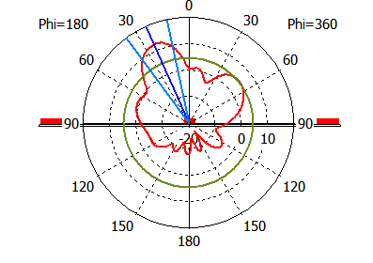
Steerability

Slide 7
Antenna parameters based on the simulation of
design
Gain: 12.5dbi
Main Lobe angular width (3db)=24 degrees

Slide 8
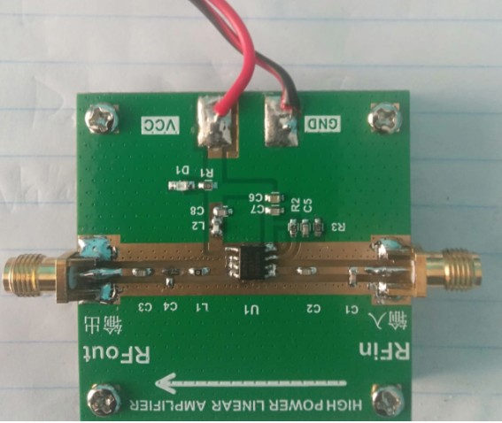
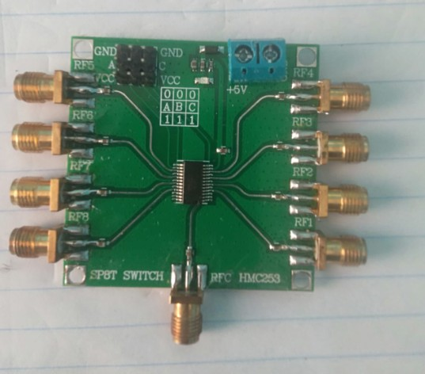
Parts Acquisition-main parts
RF power Amplifier
Antenna switch

Slide 9

Flow Charts
start
Antenna Design
Antenna
Simulations
Meet
expectations
Yes
Antenna Fabrication
No
Field test
Meet
expectations
Yes
End

Slide 10

Tasks Ahead
Antenna Fabrication
Antenna Testing-gain and directivity Range Testing
Fabrication of sensor Network

Slide 11

Thank you!

